Slide 1
Abstract
In this advanced era of technology, people believe what they see and experience through their eyes. Virtual Reality is a computer simulated reality which replicates a real environment, and simulate a user's physical presence in this environment while Augmented Reality blurs the line between what's real and what's computer-generated by enhancing what we see, hear, feel and smell. This alone showcases the potential of Virtual and Augmented Reality in fields of gaming, e-commerce, tourism, education etc. to provide real life experiences.
The proposed android application “Exploration” will be a perfect blend of virtual and augmented reality. “Exploration” will be comprised of various applications from narrating stories to children and also providing information about certain objects around you in the real world which would provide a more immersive and interactive real environment to everyone.

Slide 2
Objective
The objective of the proposed project is to provide a more immersive and interactive environment to the user to learn about different things. The projected virtual objects display details that are difficult to imagine by the user. The information conveyed by the virtual objects helps a user perform real-world tasks. “Exploration” will help to inculcate learning and provide amazing experience to kids as well as adults. It will provide them a whole new look towards virtual world using Virtual and Augmented Reality.

Slide 3
Introduction
Virtual Reality is a computer simulated reality which replicates a real environment, and simulate a user's physical presence in this environment while Augmented Reality blurs the line between what's real and what's computer-generated by enhancing what we see, hear and feel. Augmented Reality (AR) is a variation of Virtual Environments (VE), or Virtual Reality (VR) as it is more commonly called. VR technologies completely immerse a user inside a synthetic environment. While immersed, the user cannot see the real world around him. In contrast, AR allows the user to see the real world, with virtual objects superimposed upon or composited with the real world. Therefore, AR supplements reality, rather than completely replacing it.

Slide 4
Problem Statement
The traditional methods of experiencing the real world are becoming outdated day by day. With rapidly changing technology, people don't want to just see the world but also interact with it. They want to have first hand experience in learning which is possible through virtual and augmented reality.For both AR and VR, the benefits over traditional approaches are much more than just better retention and a deeper understanding. Because the technology is also interactive, the technology can be used to test and evaluate understanding and reward users who master concepts before moving on. By integrating testing into the environment itself, the content can be highly tuned and even customised based on the learning style, background or even by how fast the student is learning. The proposed android application “Exploration” will have various functionalities like providing 3d view of different tourist places objects around you in the real world and also help students to view 3d complex structure in real world which would be difficult to imagine.

Slide 5
Components of Augmented Reality
1. Tracking and Registration
Tracking and Registration is needed to know the user’s exact location in comparison to his surroundings and also is used for tracking the exact eye and head movements of the user.
2. Display technology
Head Mounted Displays [HMD] :- HMD keeps both the images of the real physical world and the virtual graphical world over the user’s world view.
Handheld Display :- These devices use video transparent techniques to relate the virtual world to the real world.Since they are easily portable and due to the bulk use of camera phones, they are used widely.
3. Real time rendering
Real time rendering means as the orientation of the target object changes in the real world, the orientation of the projected 3d object should also change simultaneously without any flickering.

Slide 6
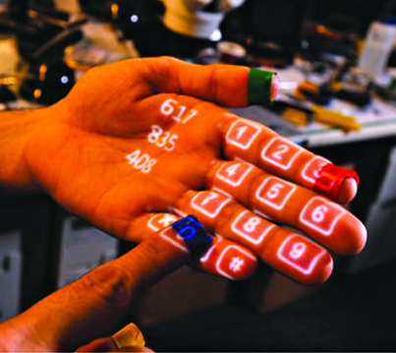
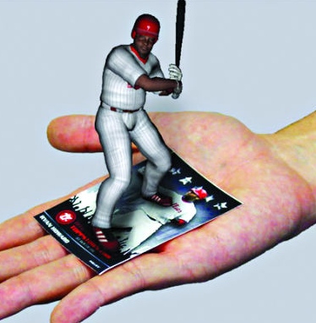
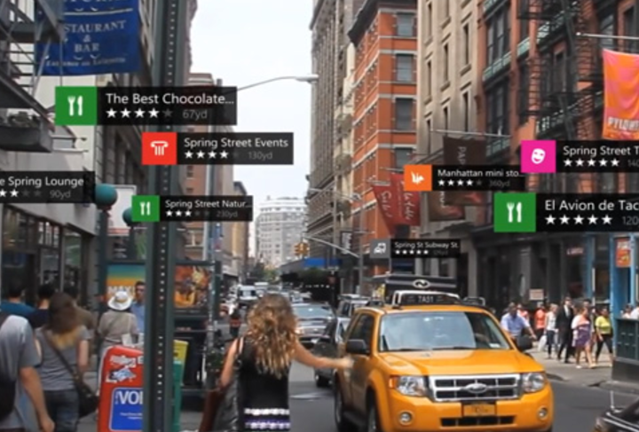
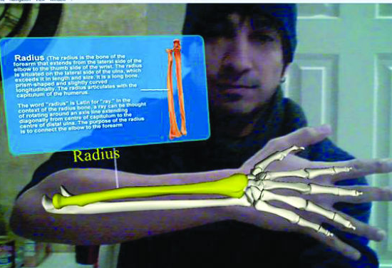
Types of Augmented Reality
Projection based AR]
Recognition based AR
Location based AR
Superimposition based AR

Slide 7
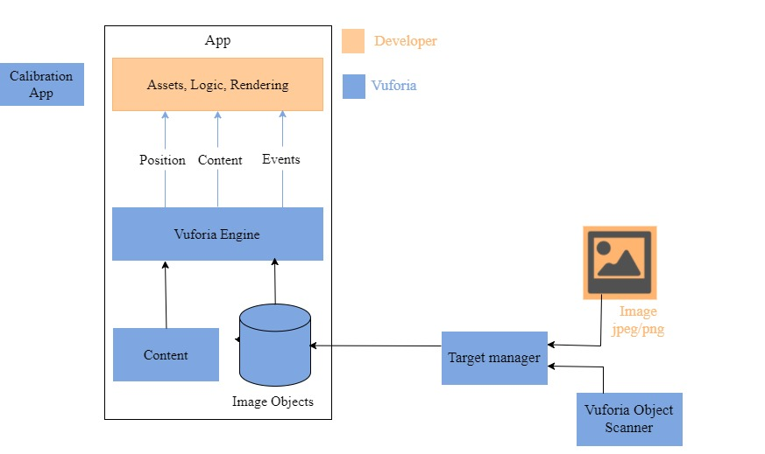
System Design

Slide 8
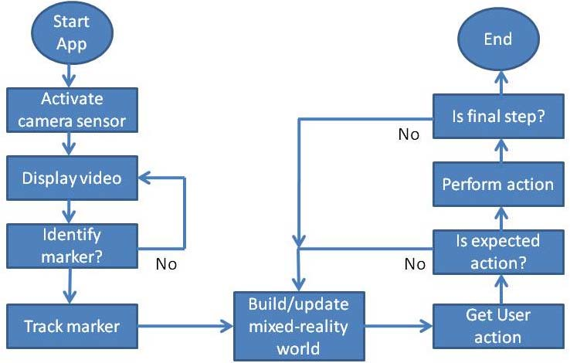
Flowchart

Slide 9
Results

Slide 10
Conclusion and Future Scope
The traditional techniques used today by students are adding very little to the practical knowledge. They need to have a first hand experience. By integrating AR into the learning process, students find themselves more engaged with the topic and will be excited by the new ideas they are being exposed to. By fostering intellectual curiosity, retention levels are considerably higher and the costs in many situations can be much lower than traditional techniques.For both AR and VR, the benefits over traditional approaches are much more than just better retention and a deeper understanding. Because the technology is also interactive, the technology can be used to test and evaluate understanding and reward users who master concepts before moving on. By integrating testing into the environment itself, the content can be highly tuned and even customised based on the learning style, background or even by how fast the student is learning.

Slide 11
References
[1] Ronald Azuma, Yohan Baillot, Reinhold Behringer, Steven Feiner, Simon Julier, Blair MacIntyre (November 2001). Recent Advances in Augmented Reality. IEEE Computer Graphics and Applications. pp 34-47
[2] Mehdi Mekni, Andre Lemieux(2014). Augmented Reality: Applications, Challenges and Future Trends. International Conference on Applied Computer and Applied Computational Science. pp 205-214. ISBN 978-960-474-368-1.

